Slide 1
A consensus protein coding gene list for use with TOIL-RNAseq output
Nick Bayley
09/14/22

Slide 2
Background
Multiple lists of protein coding genes have been used by the Graeber lab during bioinformatic analysis
These lists come from different sources:
HGNC – HUGO gene name database
RefSeq – NCBI database
Ensembl – EMBL-EBI database
GENCODE – a combination of these multiple sources of genome annotations

Slide 3
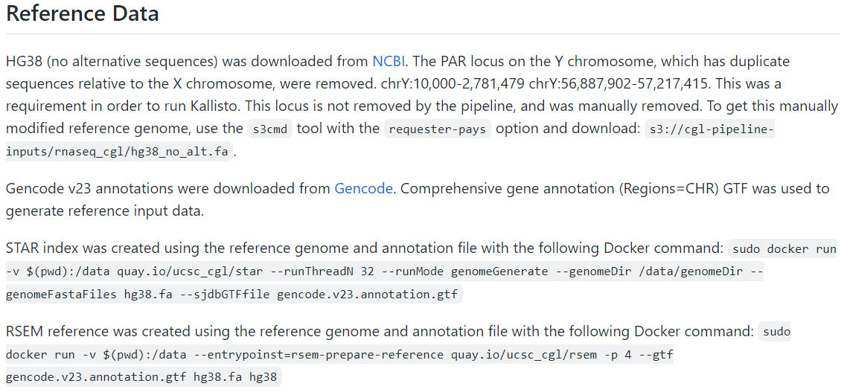
TOIL-RNAseq uses GENCODEv23
https://github.com/BD2KGenomics/toil-rnaseq/wiki/Methods

Slide 4
Methods
I gathered previous protein coding gene lists used by the lab
protein-coding_gene_modTG.txt (source: Alexzandra/Tom, DB: HGNC)
20200328 approved hgnc symbol coding emsembl.txt (source: Tian, DB: ensembl)
protien_coding_genes.txt (source: ???, DB: UCSC/NCBI?)
I then downloaded the gencode.v23.annotation.gtf from GENCODE
https://www.gencodegenes.org/human/release_23.html
filtered to gene entries with “protein_coding” gene_type entries or those ending with “_gene” for variable chain and t cell receptor genes (https://www.gencodegenes.org/pages/biotypes.html)

Slide 5
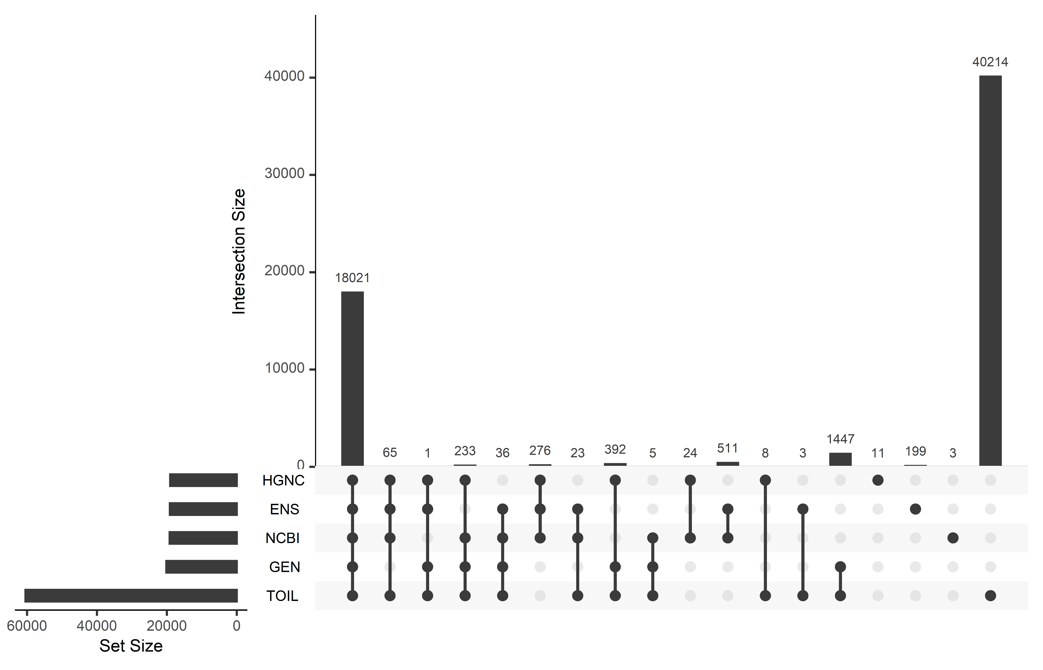
Overlap of gene lists with full TOIL RNAseq gene list output
18021 protein coding genes overlapping in all lists
GENCODE v23 has 1,447 protein coding genes overlapping with TOIL that other lists do not (red arrow)
99 genes not annotated as protein coding in GENCODE v23 but present in TOIL RNAseq and other protein coding lists (blue arrows)
GENCODE v23 has no genes missing in TOIL. All other lists have some genes missing in TOIL, suggesting different versions of gene names
TOIL RNAseq output includes ~40,000 non protein coding genes

Slide 6
Remarks
Unsurprisingly, using the genome annotations that exactly match with the TOIL RNAseq pipeline (GENCODE) led to greater overlap of gene names
Interestingly, there were 99 genes called as protein coding in newer gene lists but not in GENCODE v23
the genes are present in GENCODE v23 but annotated differently
Are these “missing” genes more recently determined as protein coding?

Slide 7
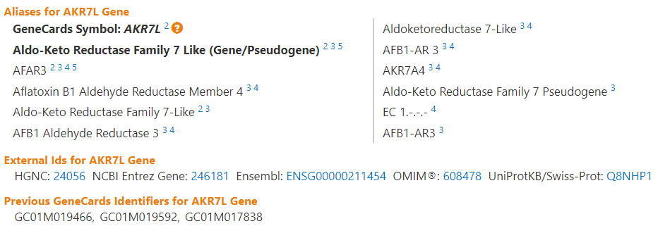
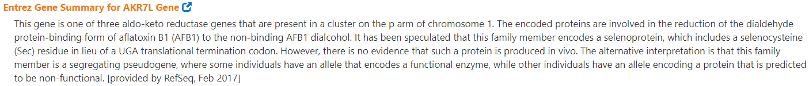
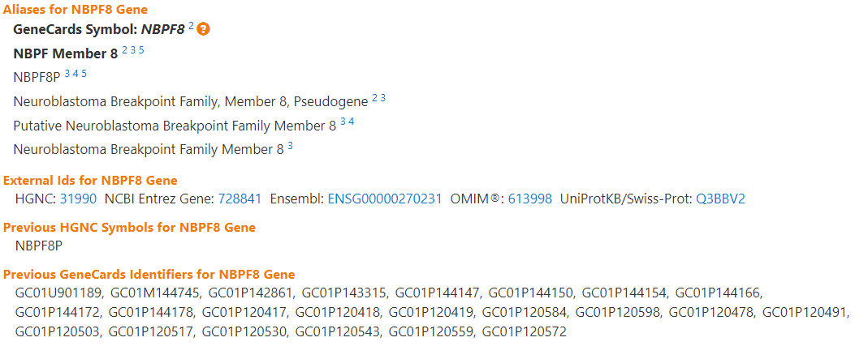
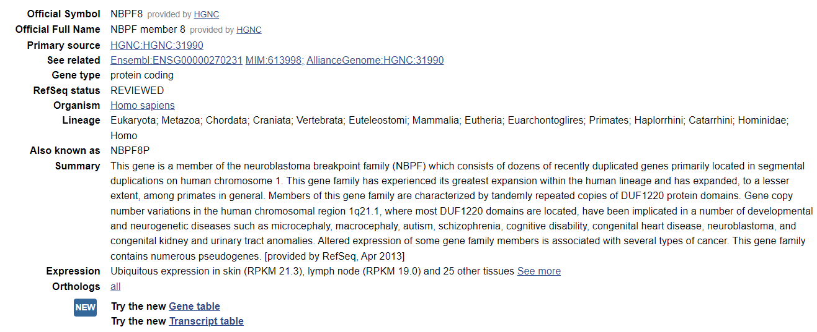
Examples:
AKR7L is annotated as gene/pseudogene as it is believed to encode a protein but there is no direct in vivo evidence
NBPF8 was previously annotated as pseudogene but more recently updated to protein coding or unknown in other databases
Other genes were clearly annotated as protein coding without qualification
These examples summarize what I observed for ~15/99 genes I checked.

Slide 8
Action Items
Should “newly annotated as protein coding” genes (relative to GENCODE v23) be included in a consensus protein coding gene list for use with TOIL RNAseq?
My vote is yes since many seem to be clearly protein coding now, and it is only 99 out of ~19,000 protein coding genes
Upload consensus gene list to Graeber lab GitHub for accessibility

Slide 9
Updates (09/28/2022)
Added “alias_symbol” column from HGNC annotations (HGNC.alias)
Added newest version GENCODEv41 annotations

Slide 10
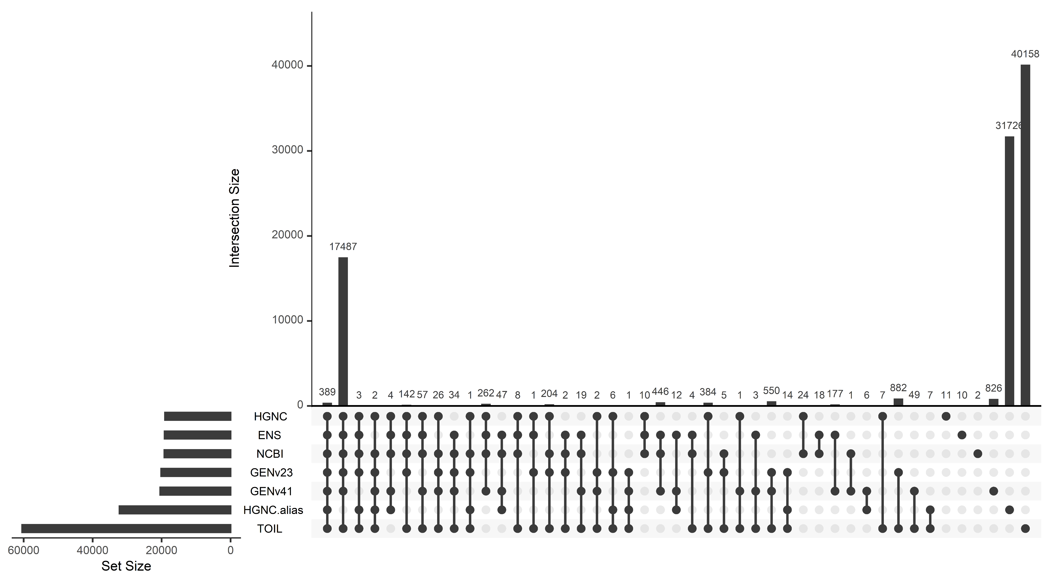
Too many overlaps…

Slide 11
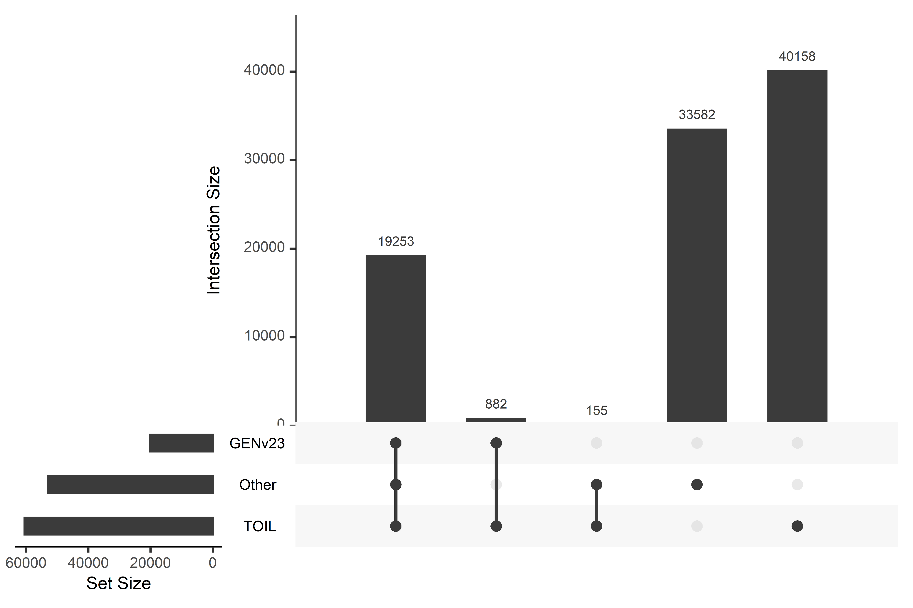
Simplified visual
Other = Union(HGNC, HGNC.alias, ENSEMBL, NCBI, GENCODEv41)
882 genes unique to GENv23 annotations
(Likely old gene names not included in newer annotations)
155 genes present in other annotations but not GENv23
(Likely genes newly annotated as protein coding)

